Slide 1
HACKCOVID(Team 1912)
By Paras Nagpal

Slide 2
One Line Pitch
Appointment System to avoid overcrowding.

Slide 3
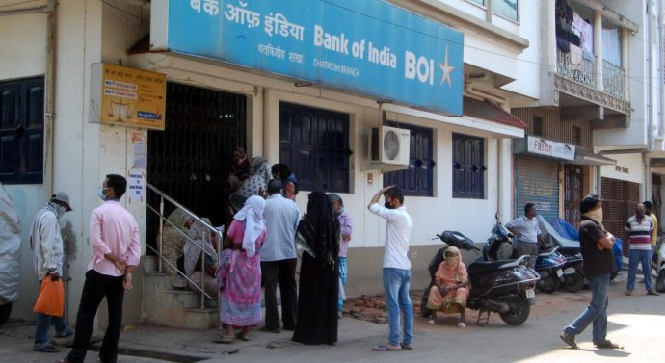
Problem
Due to Corona virus pandemic, the world is facing a huge crisis in economy as share markets witnessing the steepest fall. Indian Government imposes lockdown across the country in an effort to implement social distancing and prevent community spread of the disease. With the current situation, the Indian police department is finding it hard to enforce distancing in certain places like banks, hospitals and Mohalla Clinics in Delhi.
As a result, we witnessed two cases of Mohalla Clinic doctors getting infected and infecting the patients.

Slide 4


Solution
With this idea I propose an appointment system which can be realized very quickly and efficiently to deal with crowding problems.
Appointment scheduled.
Banking institute, Hospitals, Mohalla Clinics.
Appointment request.

Slide 5
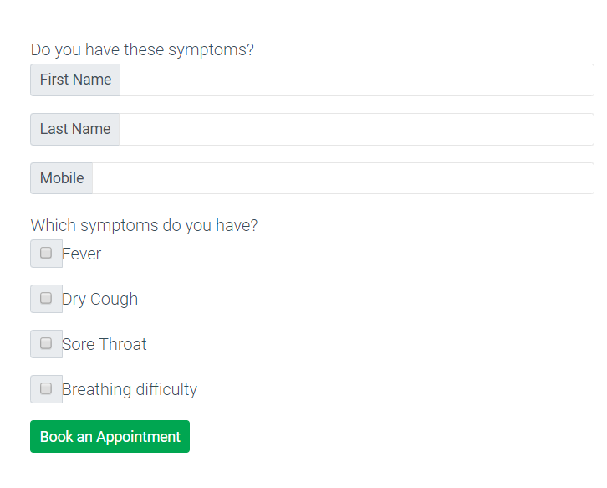
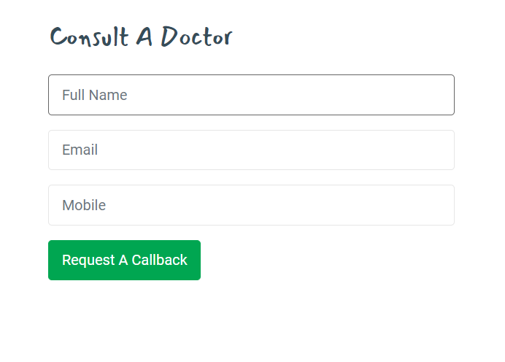
Innovation
The solution provides the citizens with a great benefit of doubt queries and uncertainties getting cleared by professional guidance.
Lets the patient book an appointment and hence avoids crowding at clinics and hospitals.

Slide 6
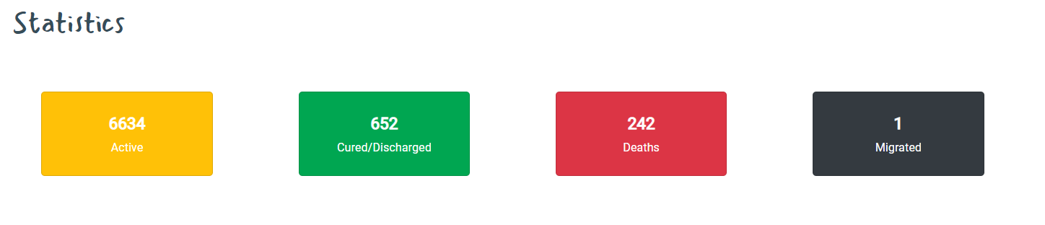
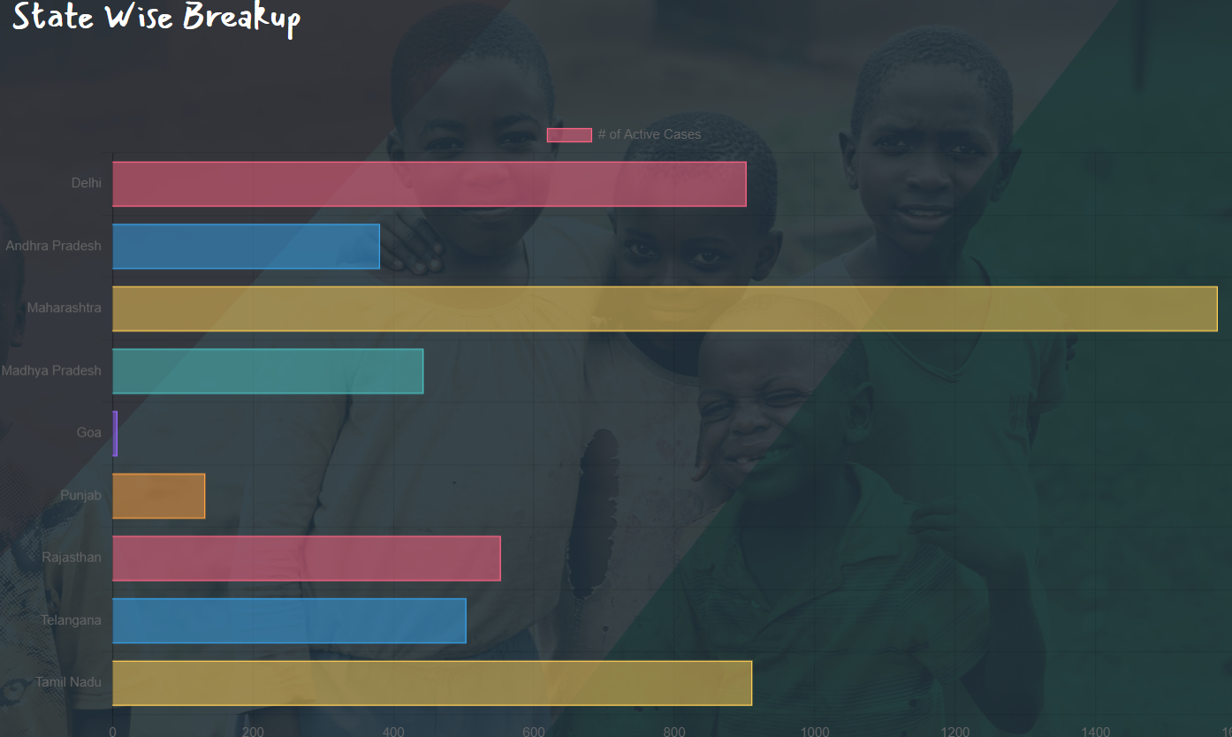
What else the website has to offer?
The combined statistics of the nation.
The state-wise breakup of the active corona cases across the country.

Slide 7
Future Aspects of the solution
I see that the solution could have a nice future for governmental institutions like banks, hospitals and clinics.
The solution could help government to track the health status of its citizens in a very efficient way.
Check out the website at : https://cocky-davinci-97a7cb.netlify.com/
Technologies Used:
Front-end : HTML,CSS,JS
Back-end : Firebase
By Paras Nagpal
HACKCOVID
Team 1912

